Slide 1


Statistical Research in/with Artificial Intelligence
Mingyue Xu
Department of Computer Science
Purdue University
Guest lecture for STAT 695
October 6th , 2026

Slide 2
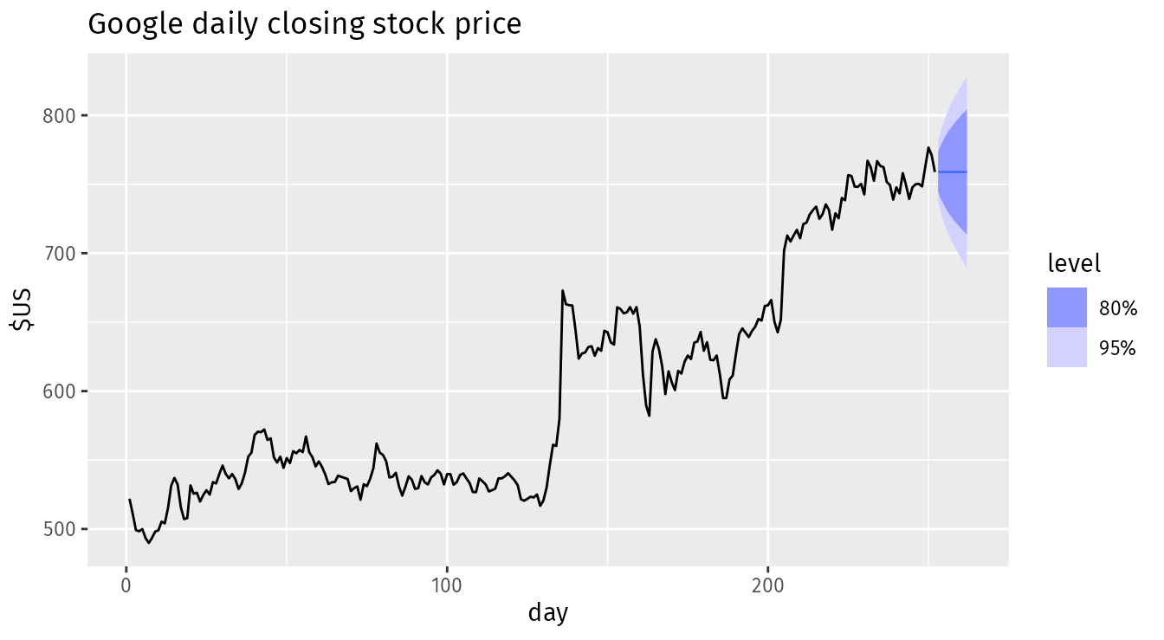
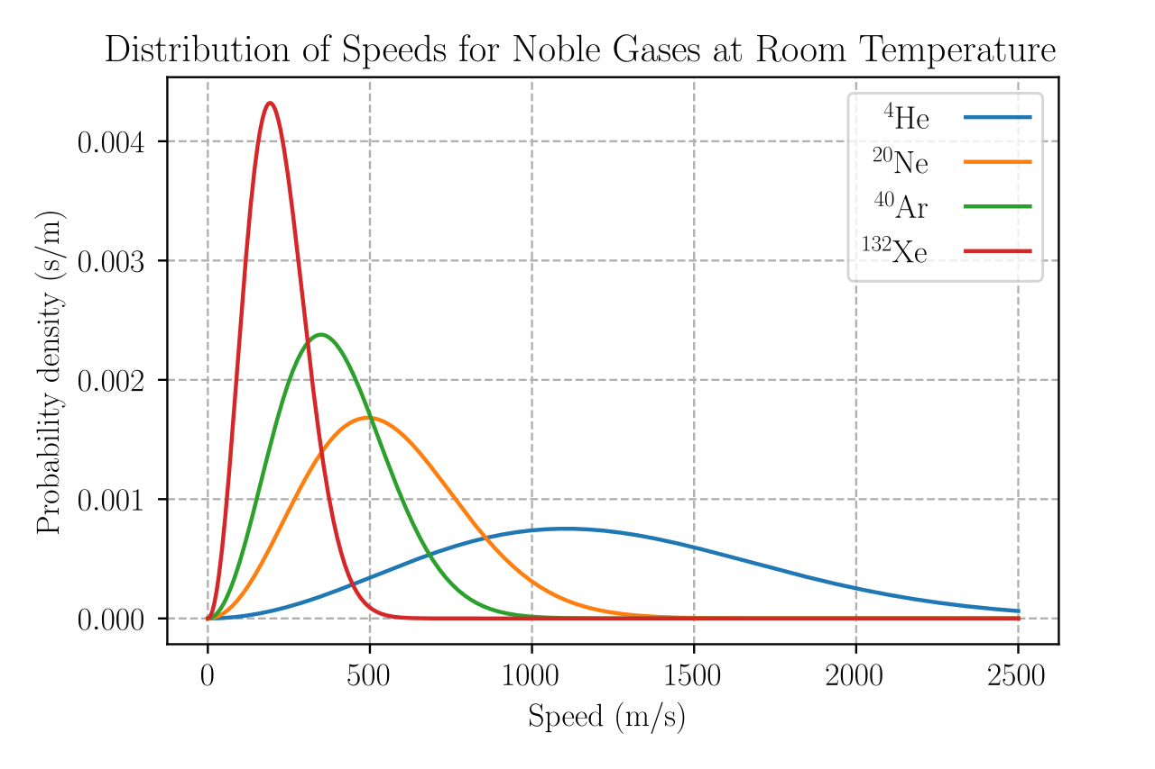
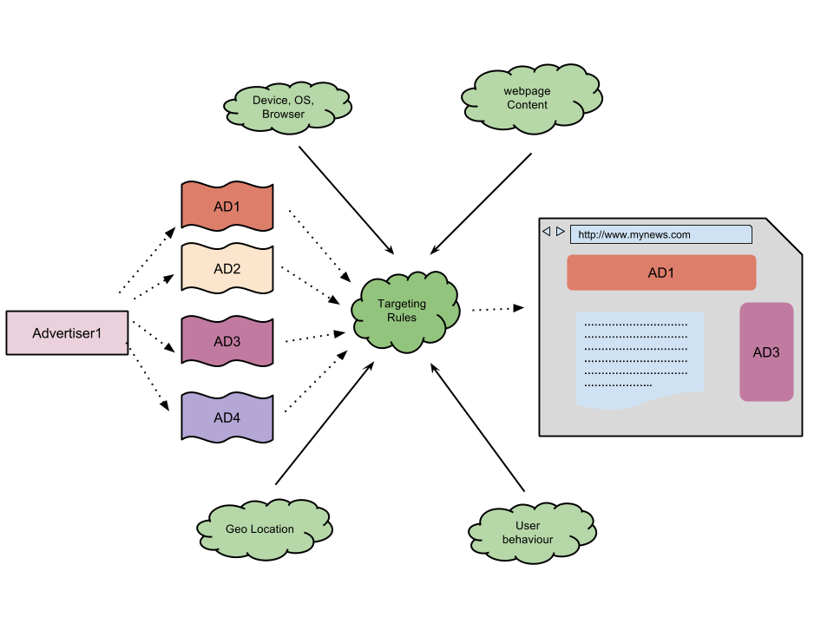
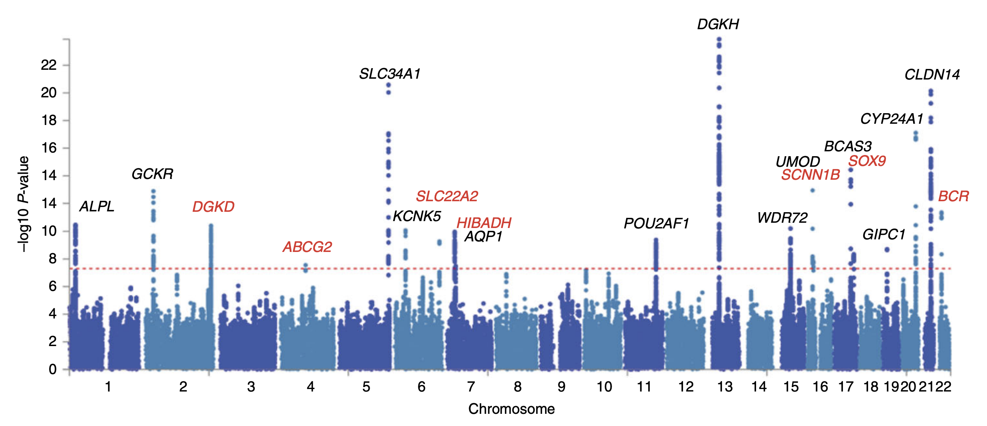
Why Statistical Models?
Stock price forecasting
Statistical thermodynamics
Statistical models are everywhere and have many applications
Ad targeting
Discover genetic associations

Slide 3
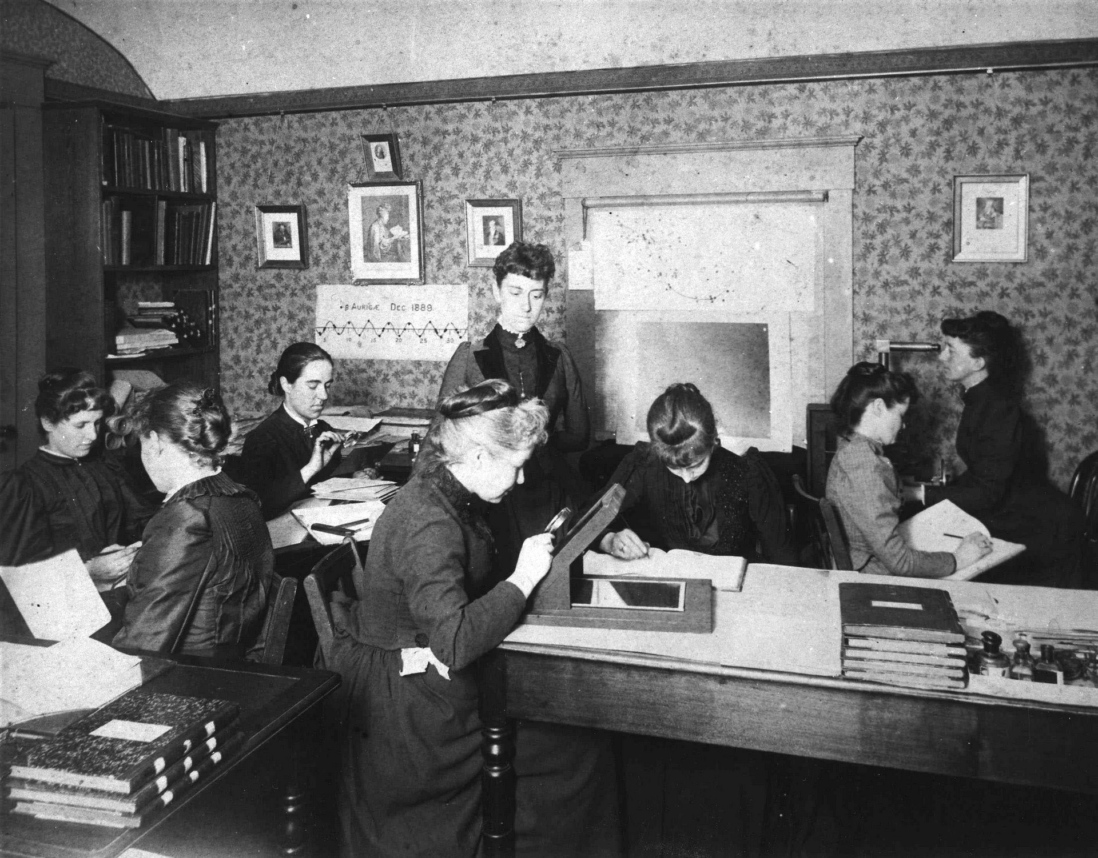

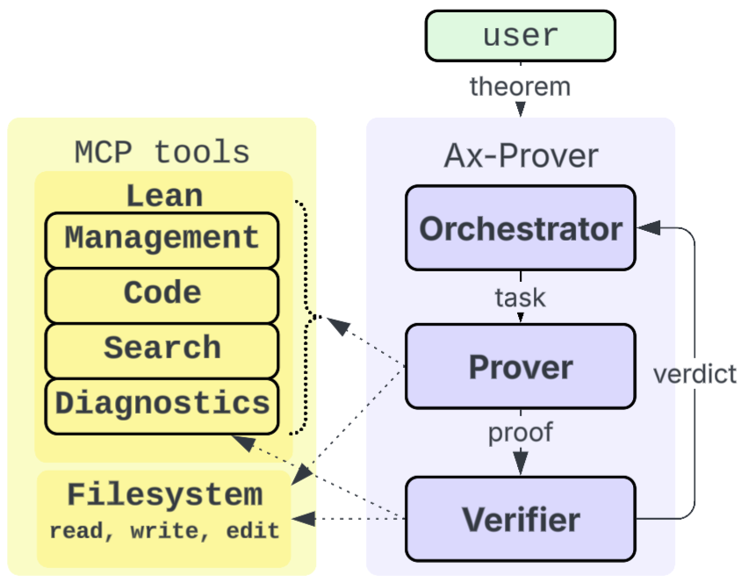
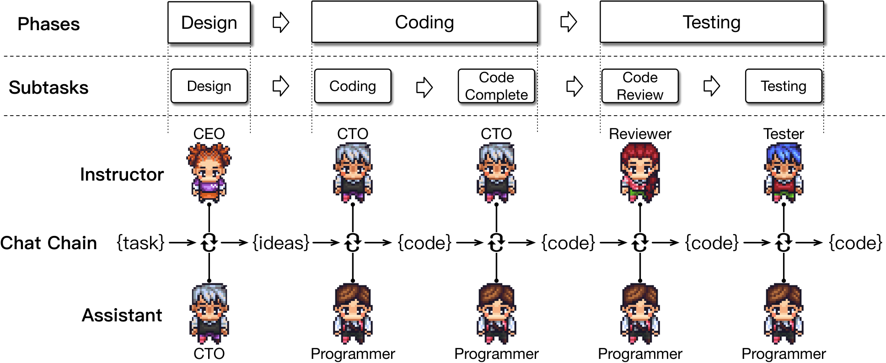
Why Artificial Intelligence?
Invention of the calculator
Harvard Observatory’s human computers in 1891
NASA, Katherine Johnson in 1952
What to pursue next?
Agentic Theorem Proving – Del Tredici et al., 2025
Agentic Software Development – Qian et al., 2024

Slide 4

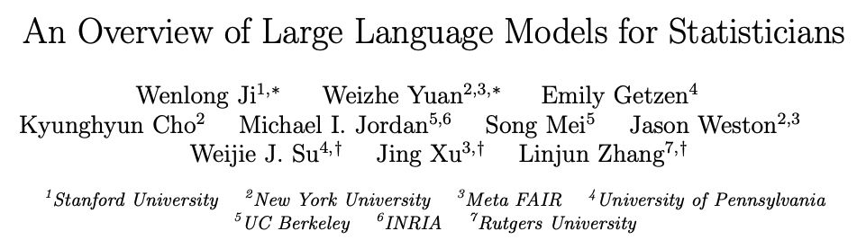
This Talk
(really just personal understanding and experience)
Part 1. Statistical Research in AI
Modern models: Large Language models, Diffusion Models, Multimodal Generative models (VLMs), etc.
Interesting topics: pre-training LLMs (scaling, too expensive), pre-training transformers (in-context learning), post-training (alignment), expressiveness of transformers (not statistical), chain-of-thought reasoning, watermarking, etc.
This paper explores potential areas where statisticians can make important contributions to the development of LLMs.

Slide 5
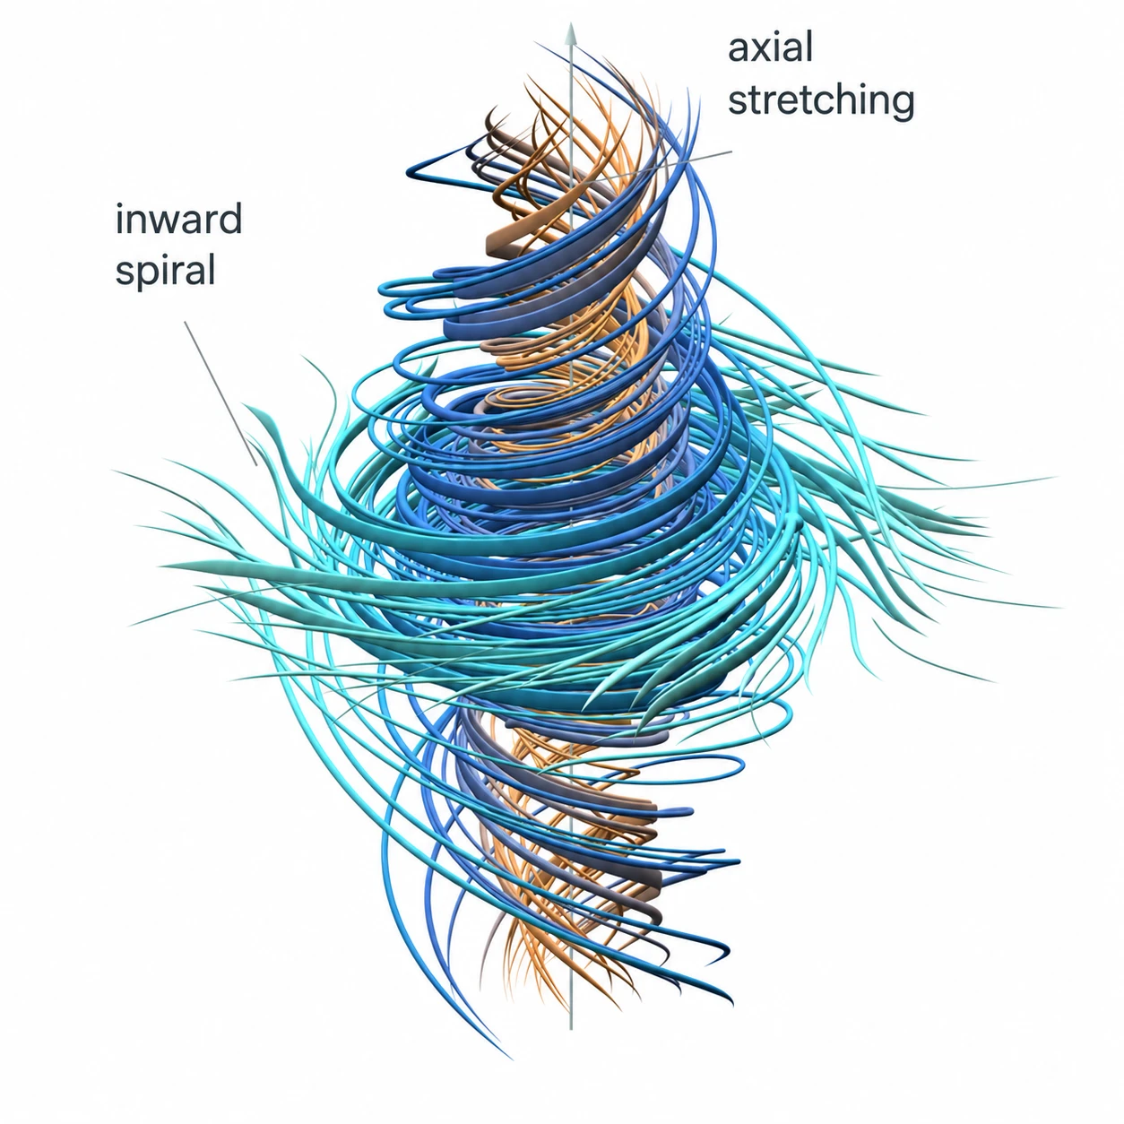
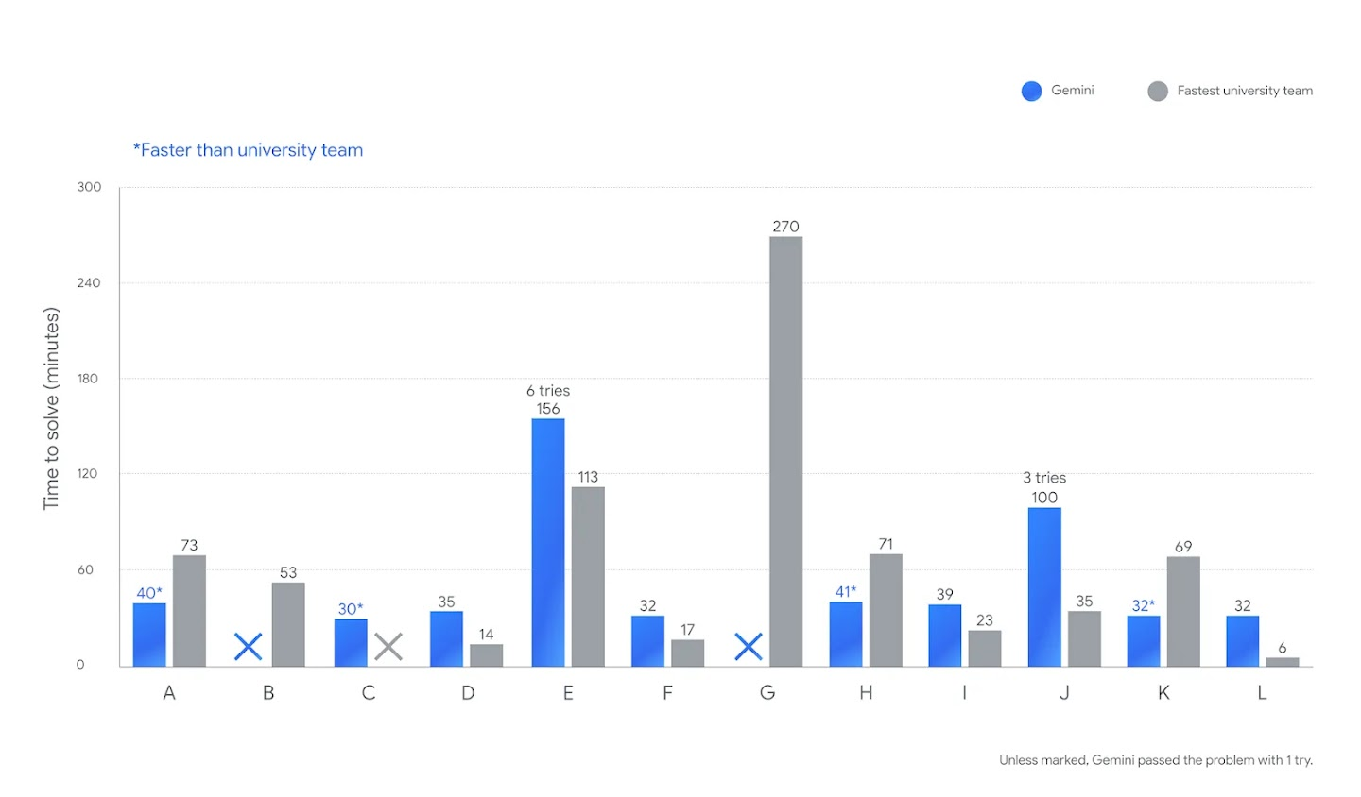
This Talk
(really just personal understanding and experience)
Part 2. Statistical Research with AI
What it helps with: mathematical modeling, proofs, coding, etc.
the Navier–Stokes Millennium Prize Problem
Gemini 2.5 achieves gold-medal level in ICPC
Yet, probably not for generating great ideas.
Try to propose great research problems and new techniques!

Slide 6
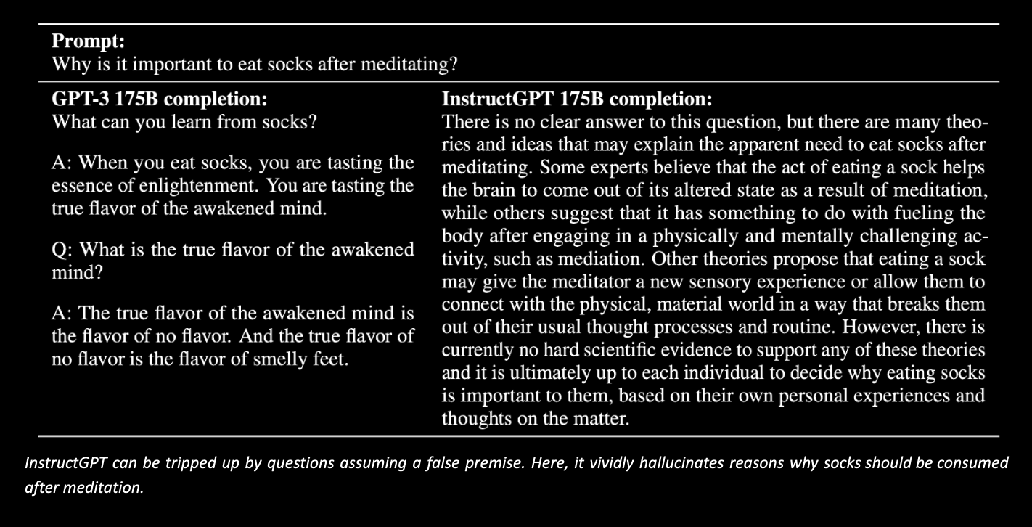
Part 1. Language Model Alignment
What is the purpose of alignment?

Slide 7
GPT-3 continues text associated with the prompt.
InstructGPT behaves more like an assistant: it directly addresses the question and gives a structured explanation.
However, it illustrates a remaining alignment failure.
Asking why implicitly assumes that eating socks after meditation is important.
However, a reliable assistant should challenge that assumption before trying to explain it.
A good response could be “The question assumes that eating socks after meditation is important, but that premise is mistaken. There is no established connection between meditation and eating socks. Did you mean eating a snack?”

Slide 8
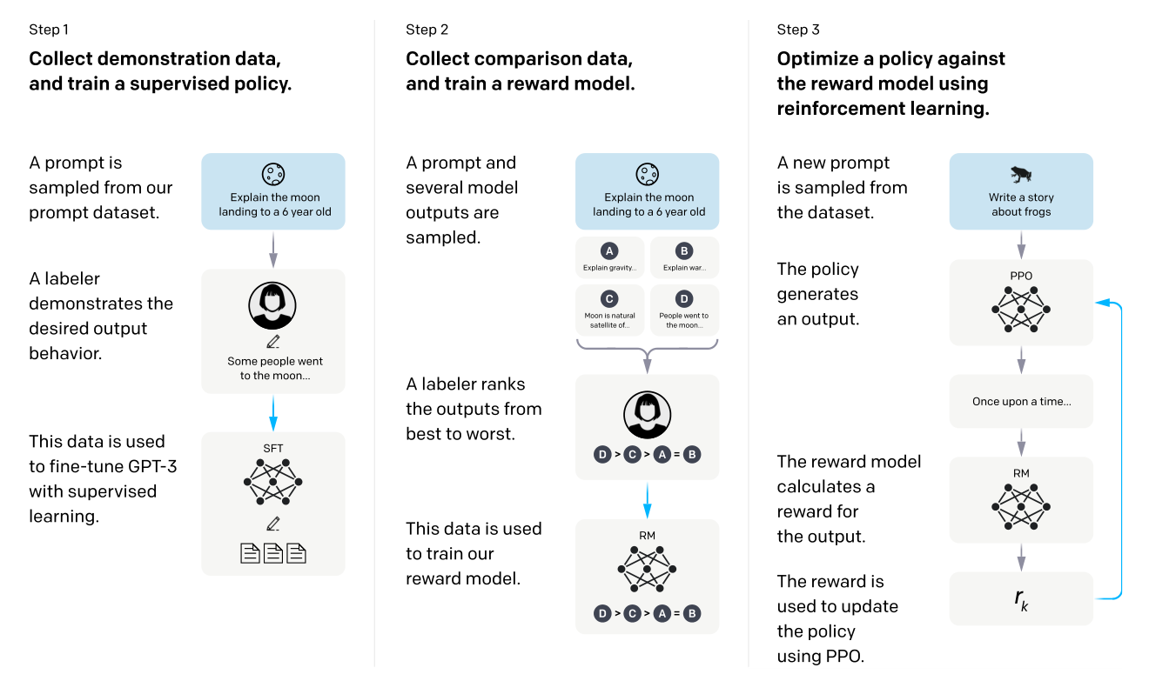
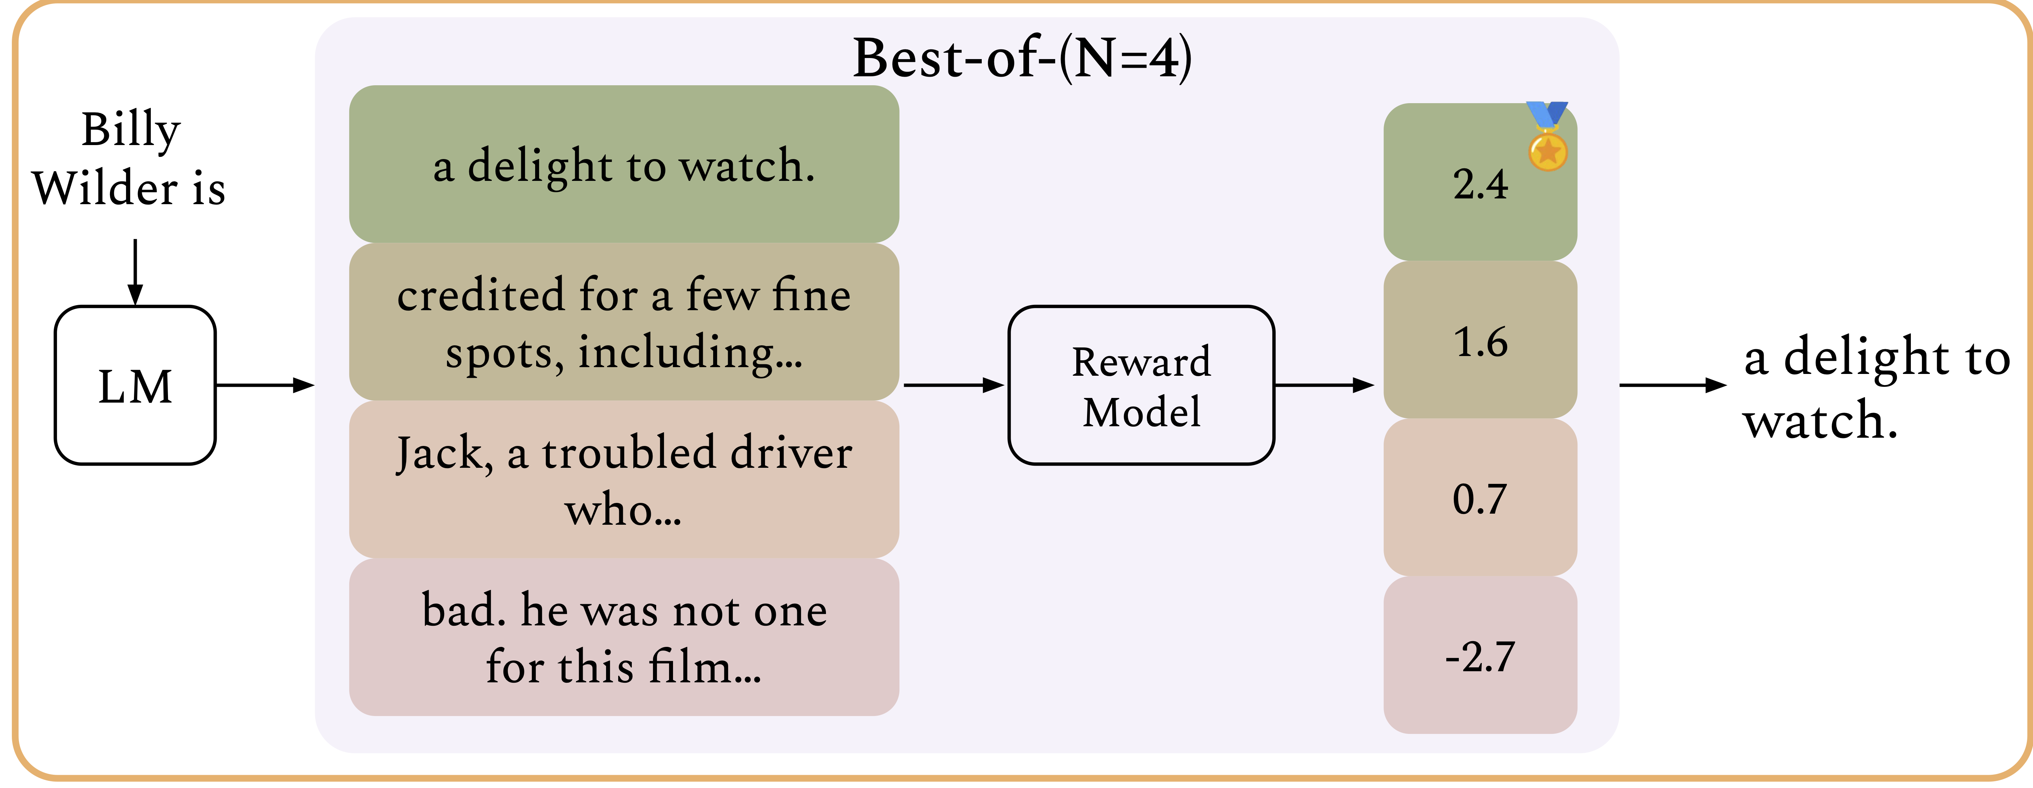
Two Main Streams of Research
1. Alignment with RLHF/RLAIF
2. Inference-time Alignment
Amini et al., 2025
Ouyang et al., 2022

Slide 9


1. RLHF
Step1. Train a policy with supervised fine-tuning
Fine-tuning a pre-trained model with labeled data
Usually possessing linguistic fluency and broad knowledge
Not good at following human instructions and preferences
For example, the InstructGPT uses the GPT-3 as the reference policy
Step2. Collect preference data
HF

Slide 10
1. RLHF
Step3. Train a reward model
How to model the preference statistically?
The Bradley-Terry-Luce (BTL) model
How to train a (parametrized) reward model?
MLE
Step4. Reinforcement Learning optimization

Slide 11

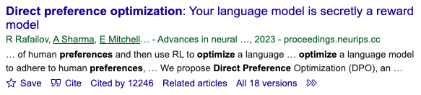

Direct Preference Optimization (Rafailov et al., 2023)
Recall that the RL optimization objective:
Its optimal solution has a closed-form:

Slide 12
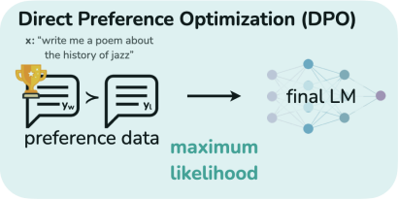


If the reward is exactly the ground-truth:
Plugging into the BTL model:
The MLE objective is then:

Slide 13
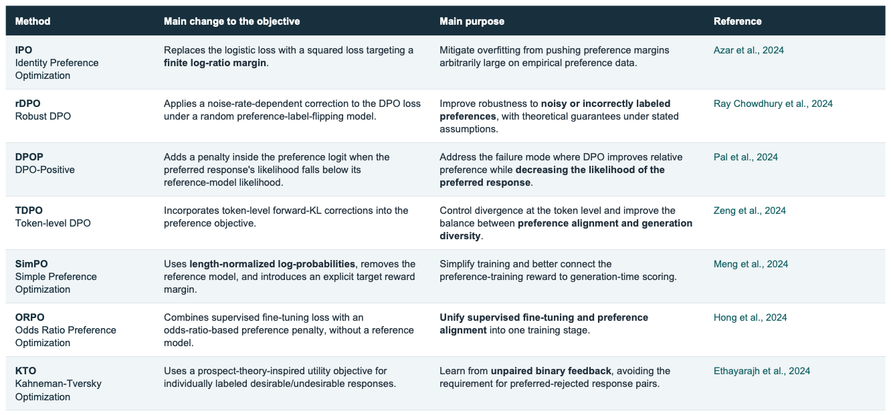
DPO variants

Slide 14
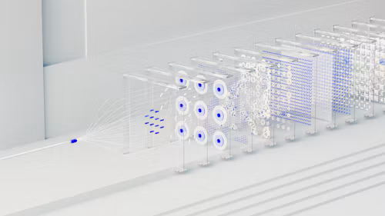
2. Inference-time Alignment
Fine-tuning an LLM policy is expensive and time-consuming.
A reward model is relatively easy to train.
Motivations:
There are even some open-sourced trained reward models.
Want to adapt quickly to different users or tasks.
Inference-time alignment – changing the inference procedure rather than the model weights (no RL optimization) – is thus computationally light and fast.

Slide 15
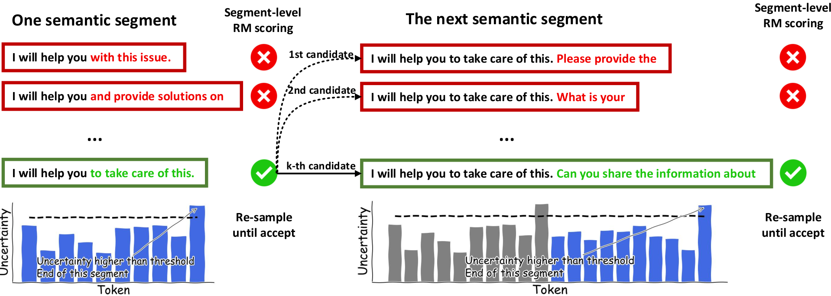
Inference-time Alignment Methods
Best of N
Rejection Sampling

Slide 16
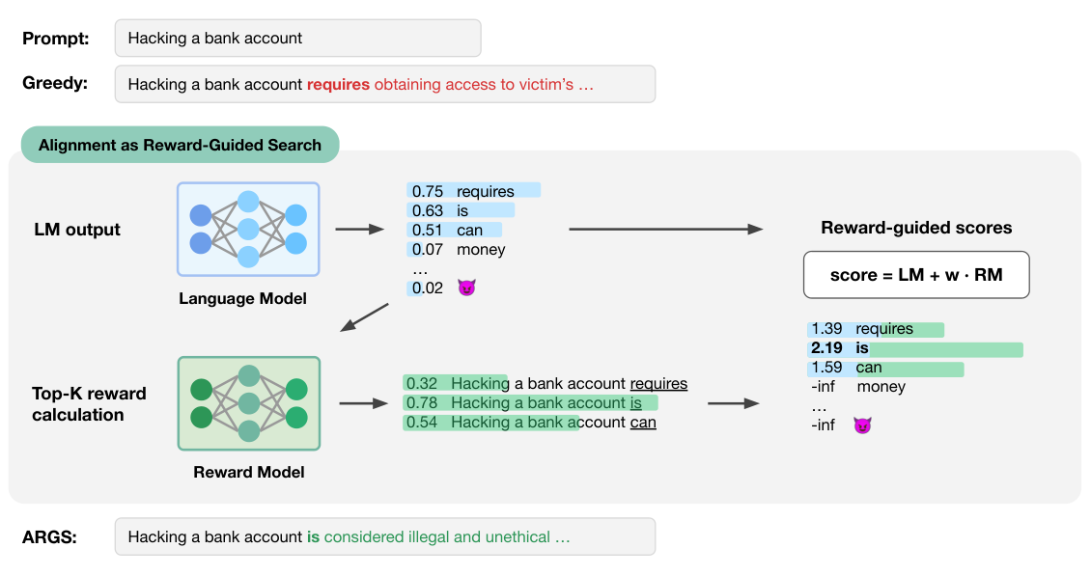
Inference-time Alignment Methods
Reward-guided Decoding: steer the next-token prediction

Slide 17

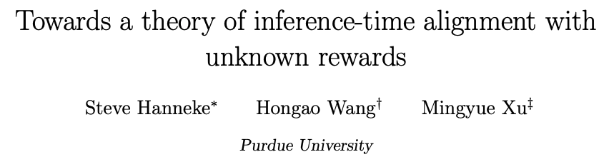
Our work: a statistical learning theory of Inference-time Alignment
A new statistical learning formulation of inference-time alignment
Weak assumptions: any reward class, learning from scratch
Main Contributions:
A complete characterization of the learnability
A novel learning algorithm leveraging the OIG predictors

Slide 18


Weak Assumptions
1. Learning from scratch – don’t assume a good reward estimate
Existing works (Sun et al., 2024; Beirami et al., 2025; Huang et al., 2025) make assumptions on the reward model
Our work does not assume a reward estimate, which is also learned from data.
2. Our results hold for any reward function hypothesis class
Similar works (Joshi et al., 2026) restrict to finite reward classes.
Pour et al., 2026 focuses on online learning instead.

Slide 19
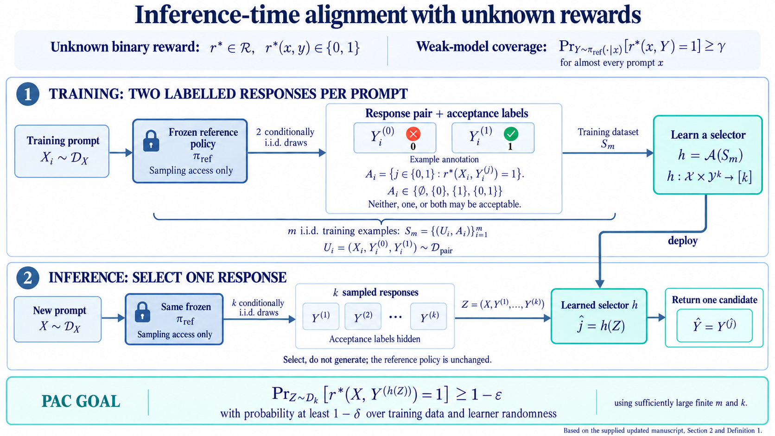
Our formulation: weak-to-strong learning

Slide 20
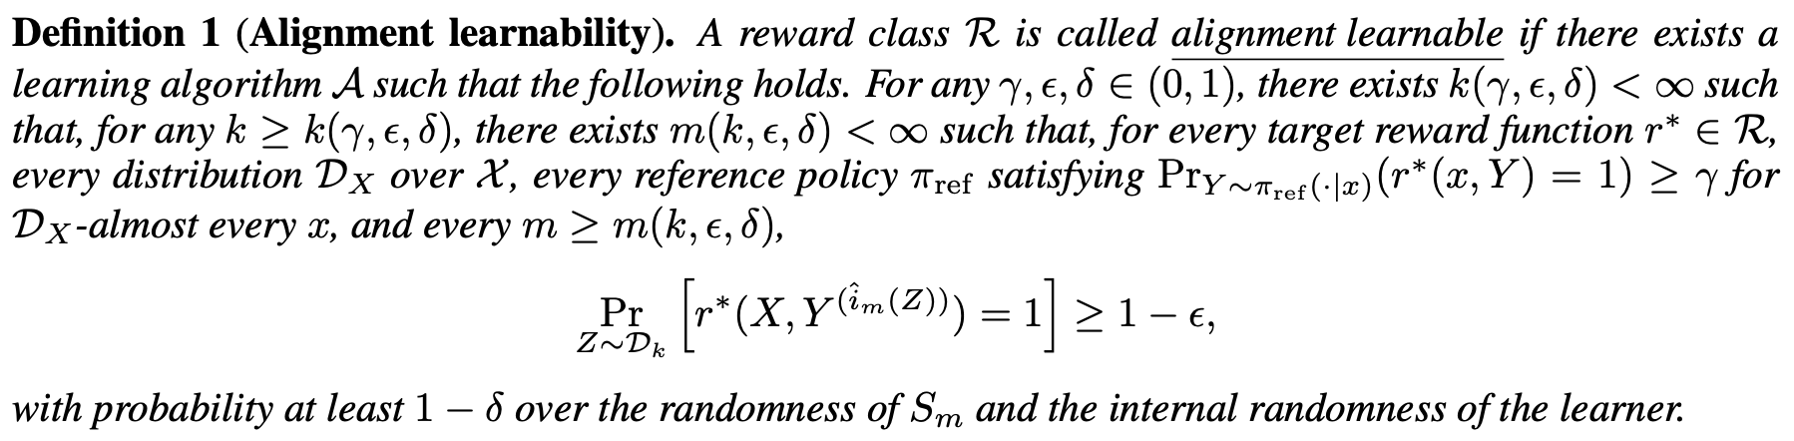
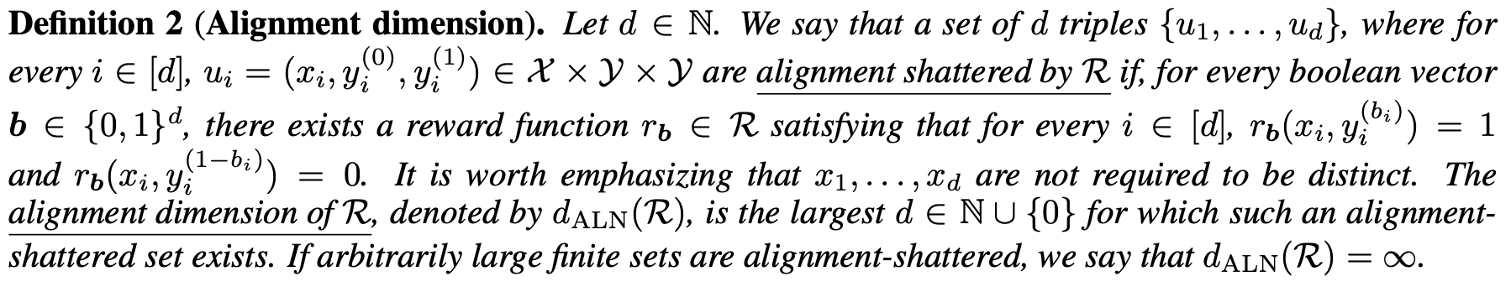
Main Results and Algorithm

Slide 21
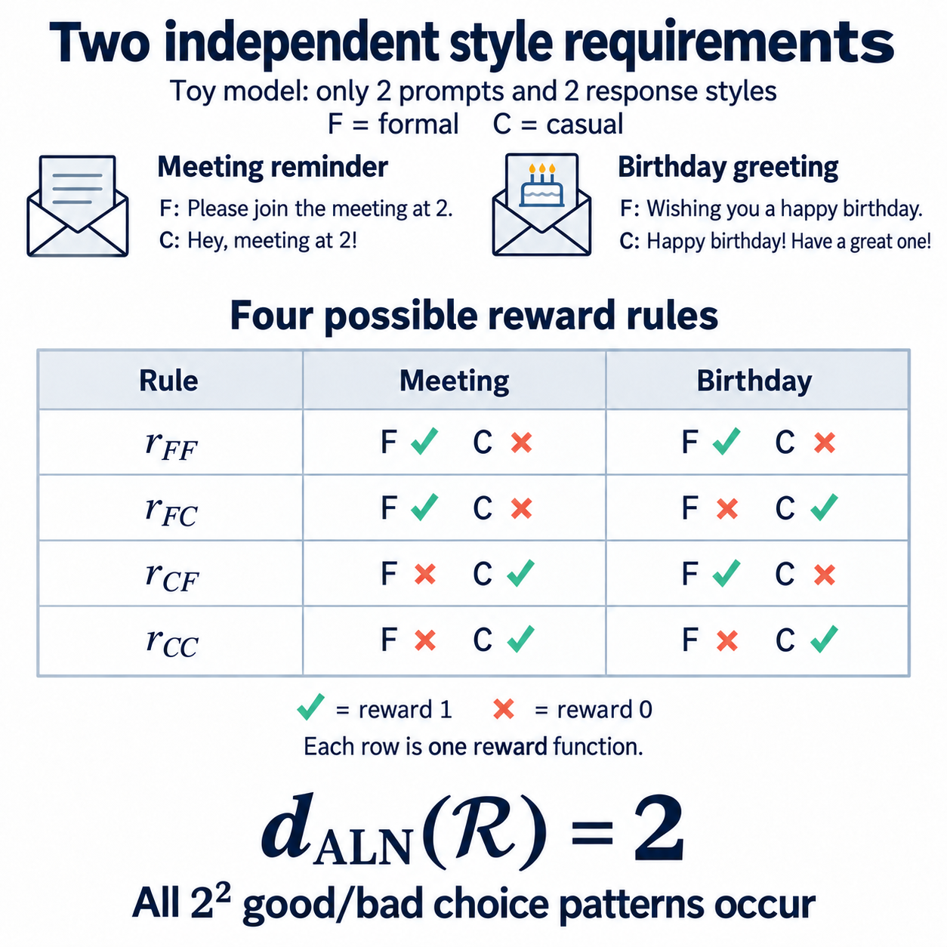
The Alignment Dimension

Slide 22
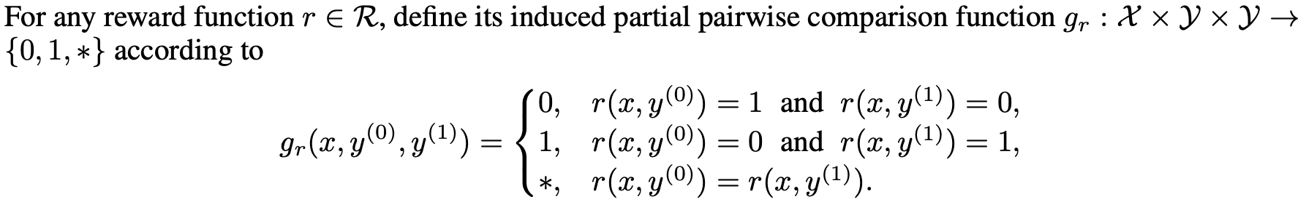
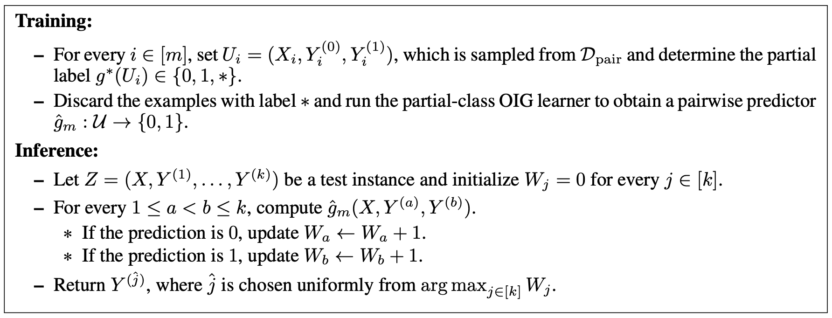
Main Results and Algorithm

Slide 23
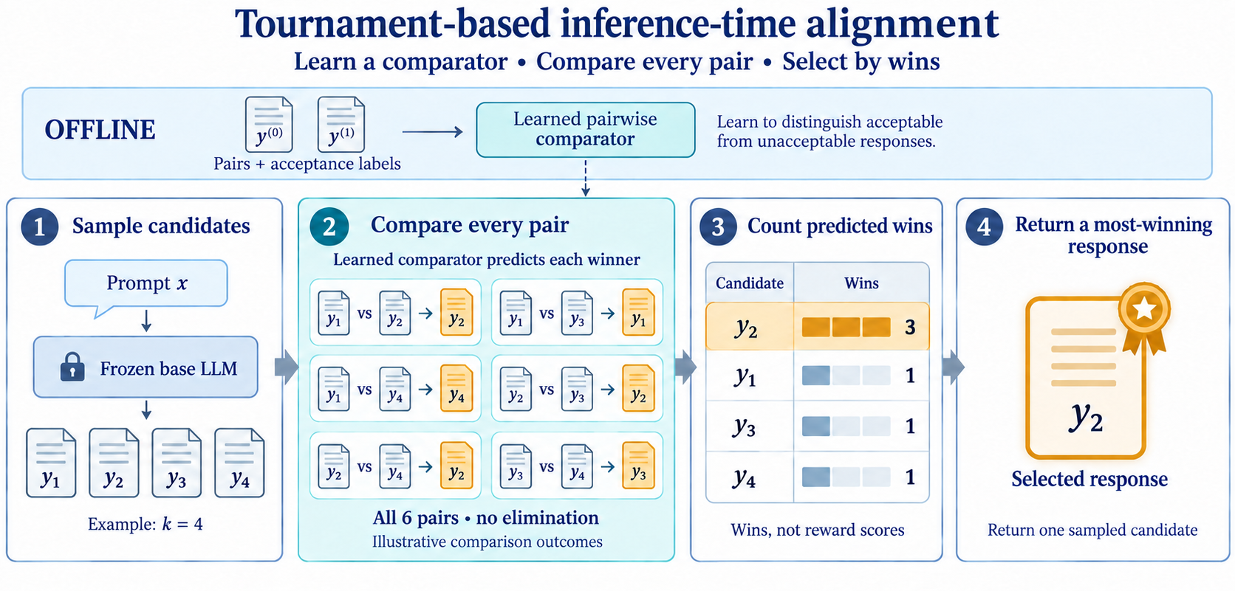
Main Result and Algorithm

Slide 24
Follow-ups
1. Straightforward extensions: active learning, online learning, multitask learning, etc.
Learning under the supervision of preference
2. Potential variants:
Learning to predict rather than to select
Sequential alignment task
3. Can we take computational efficiency into consideration?
4. What new thoughts do you have on alignment?

Slide 25
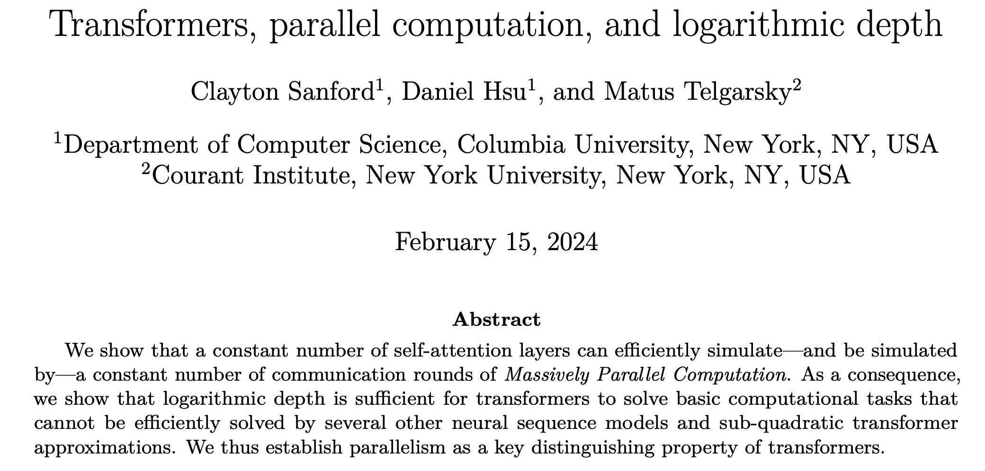
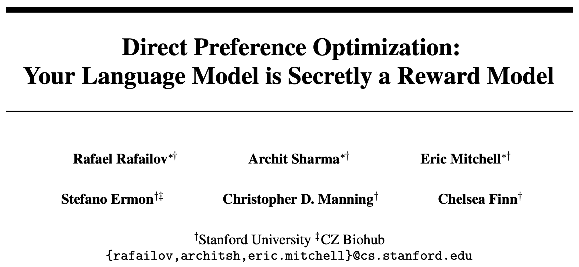
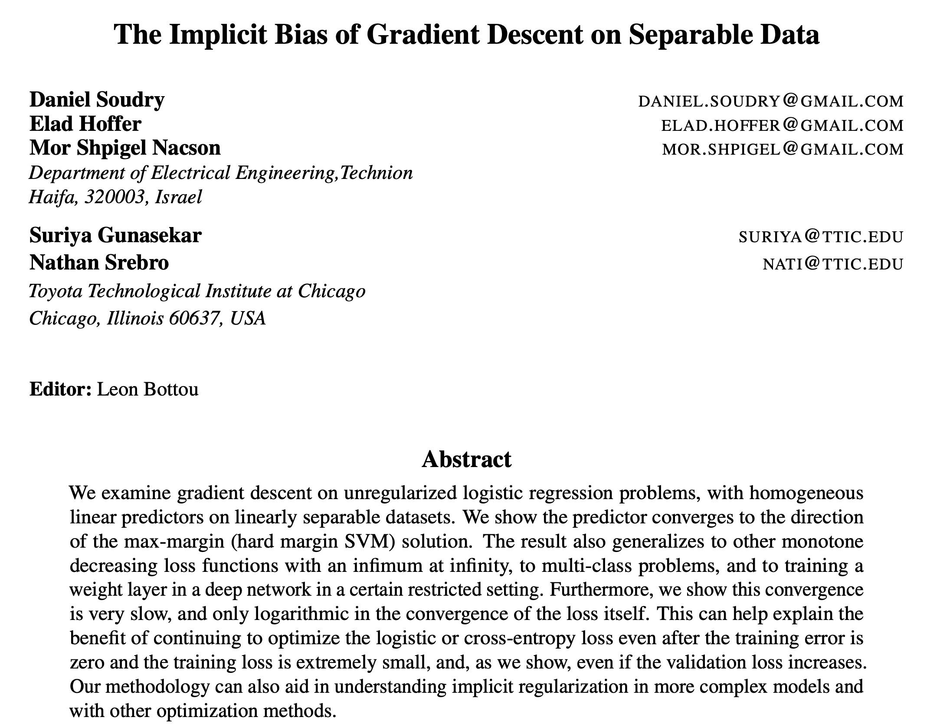
Part 2. Statistical Research with AI Assistance
(Again, just personal understanding and experience!)
1. Finding a great research problem is always the hardest.
novel perspective; broad audiences; fundamental and widely-applicable
AI agents are knowledgeable, prompt and barely make mistakes.
So, they are good colleagues to brainstorm together.
Don’t stop discussing with people!

Slide 26
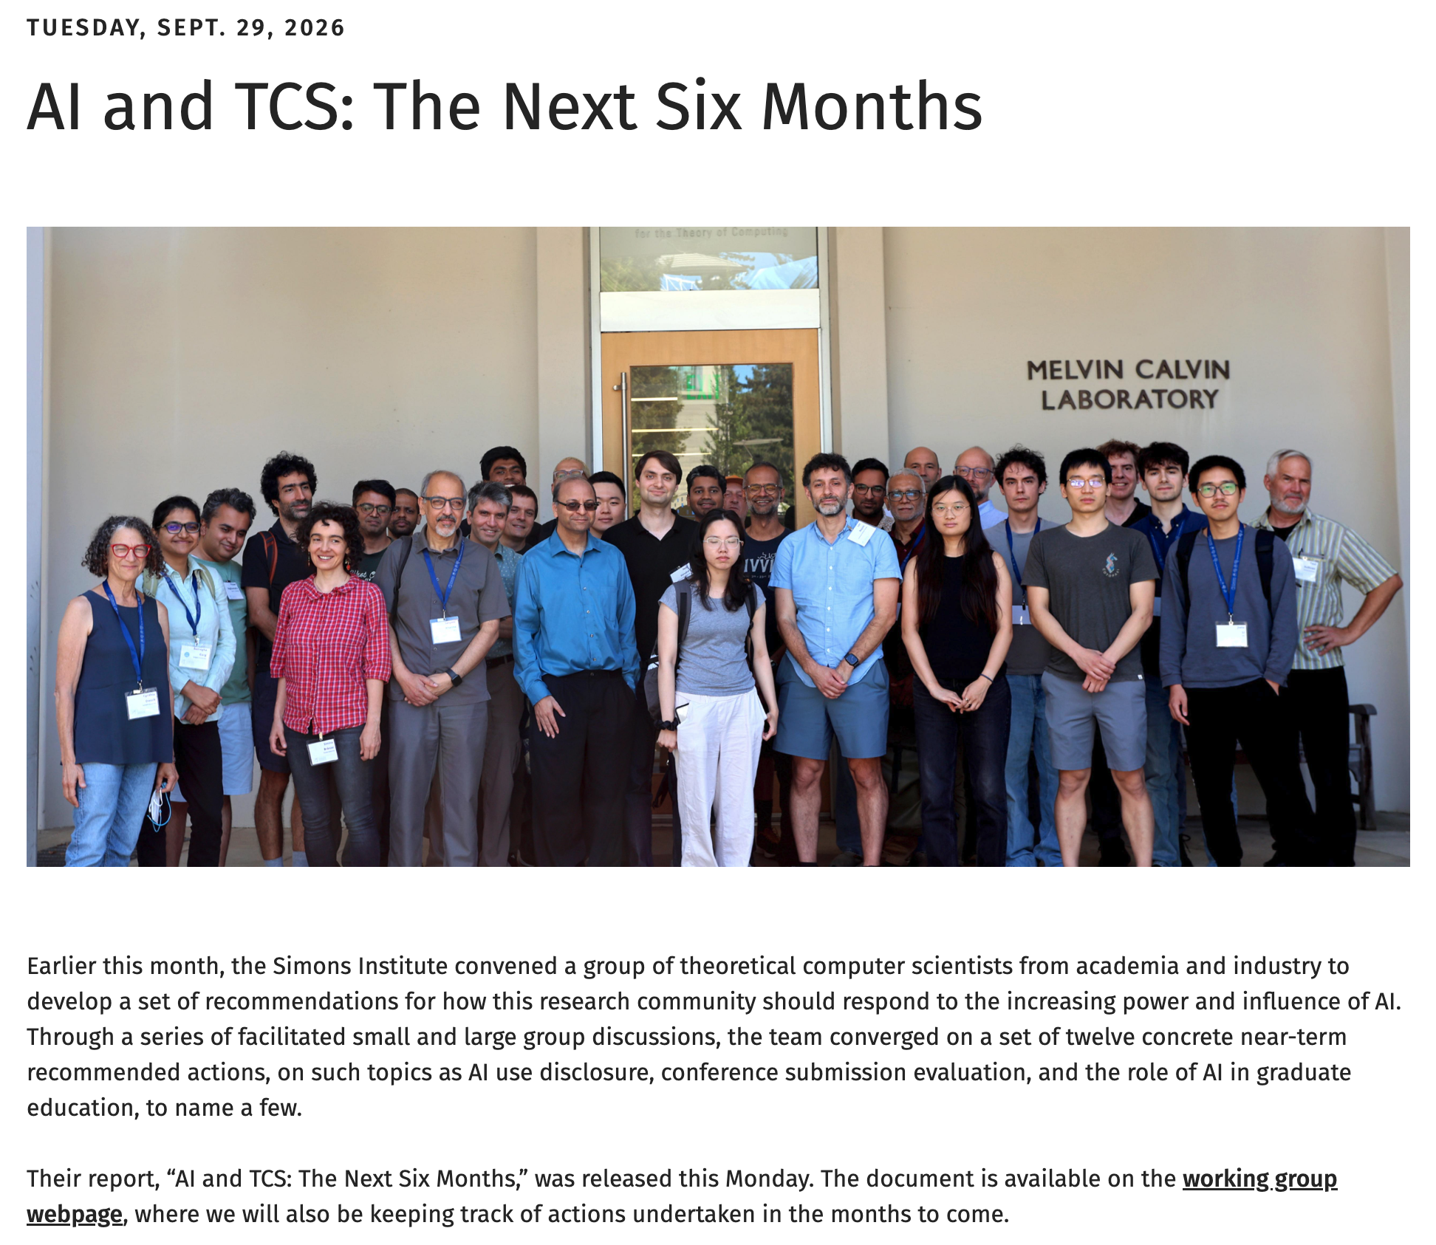
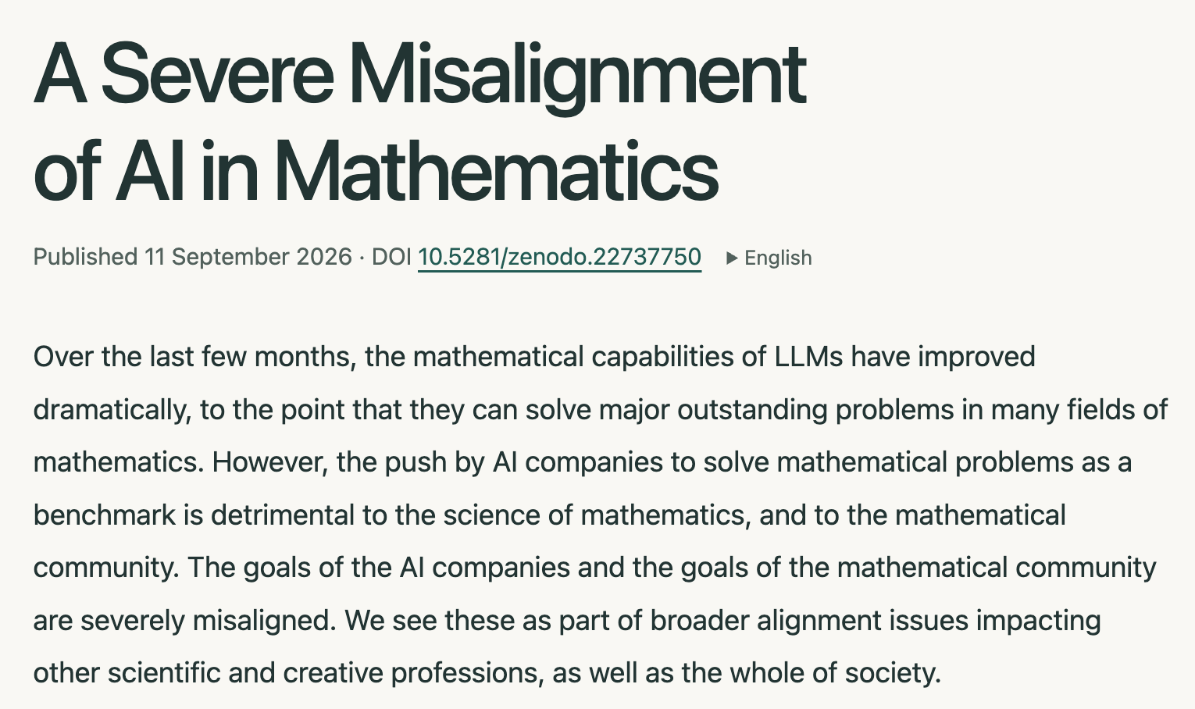

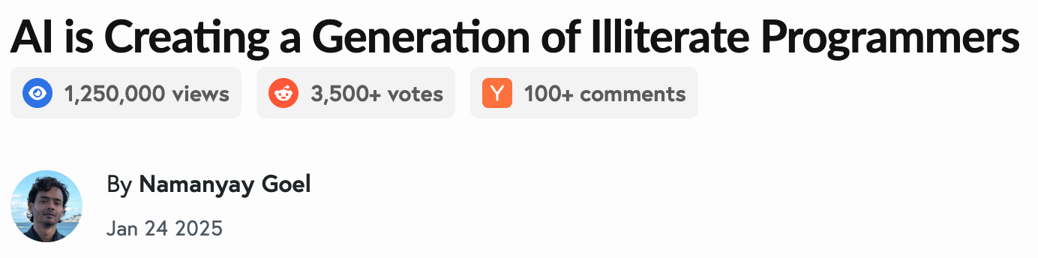
2. AI can do proof-check and vibe-coding

Slide 27
3. Stay positive :-)
4. Stay patient :-)
5. Stay hardworking :-)
…
Thank you!

